Slide 1
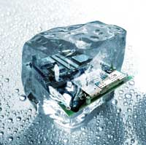
Design pattern Introduction
Hoa Vo
Quan Tran
2015.09.26

Slide 2
Software issue
Problems when developing software
Readable
Maintainable
Scalable
Testable
…

Slide 3
How it make
SEs (Software Engineers) tried to solve
They collected the good designs which solve the general problems.
In 1987, Kent Beck and Ward Cunningham began experimenting with the idea of applying patterns to programming.

Slide 4
What
Represent the best practices used by experienced object-oriented software developers
Solve general problems that software developers faced during software development
These solutions were obtained by trial and test by numerous software developers.

Slide 5
Why
Speed up the development
Prevent “Reinventing the wheel”
Save a lot of effort for designing
Improve code quality

Slide 6
Type
Creational
Behavioral
Structural

Slide 7
Creational
Abstract Factory
Factory Method
Prototype
Builder
Singleton

Slide 8
Structural
Adapter
Composite
Bridge
Decorator
Facade
Flyweight
Proxy

Slide 9
Behavioral
Chain of Resp.
Command
Interpreter
Iterator
Observer
Strategy
…

Slide 10
Practice
DoJo

Slide 11
OOP concepts
OOP concepts: Abstract class, interface, inheritance, polymorphism … use for ??

Slide 12
Structural
Facade
(fəˈsɑːd)

Slide 13
Problem
The system is very complex or difficult to understand
System has a large number of interdependent classes

Slide 14
How
Hides the complexities of the system
Provides an interface to the client using which the client can access the system

Slide 15
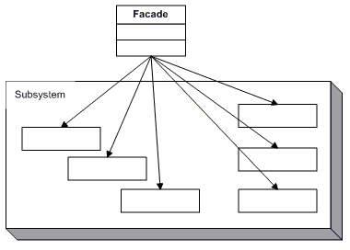
UML

Slide 16
Let code

Slide 17
Behavioral
Observer

Slide 18
When
An object want to notify other objects automatically

Slide 19
How
Calling one of their methods

Slide 20
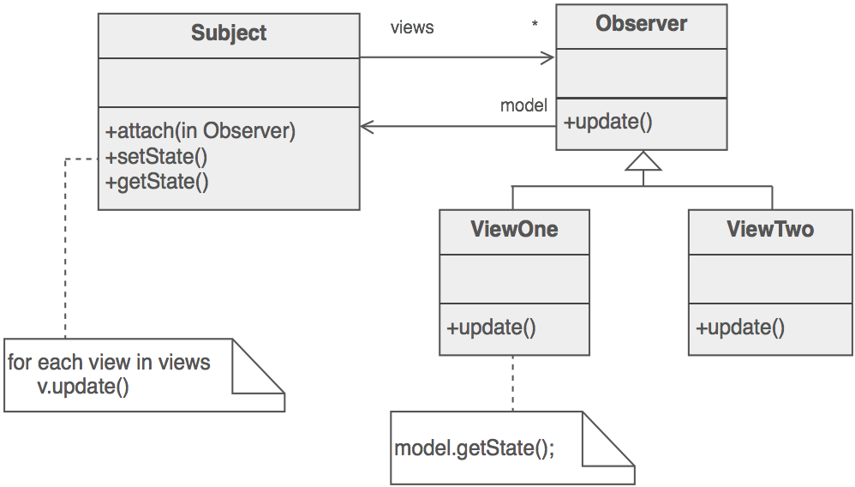
UML

Slide 21
Practice
Let code

Slide 22
Behavioral
Strategy

Slide 23
When
Have a family of implementation
Make them interchangeable

Slide 24
How
Capture the abstraction in an interface
Bury implementation details in derived classes

Slide 25
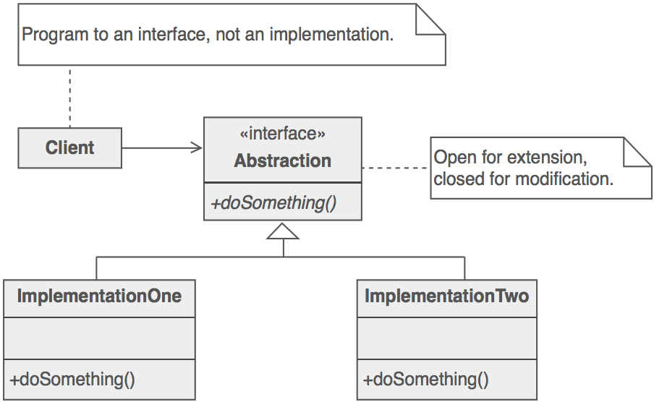
UML

Slide 26
Practice
Let code

Slide 27
Behavioral
Iterator

Slide 28
When
Need a way to access the elements of an aggregate object sequentially

Slide 29
Hide all element inside container
The container provide interface to access element

Slide 30
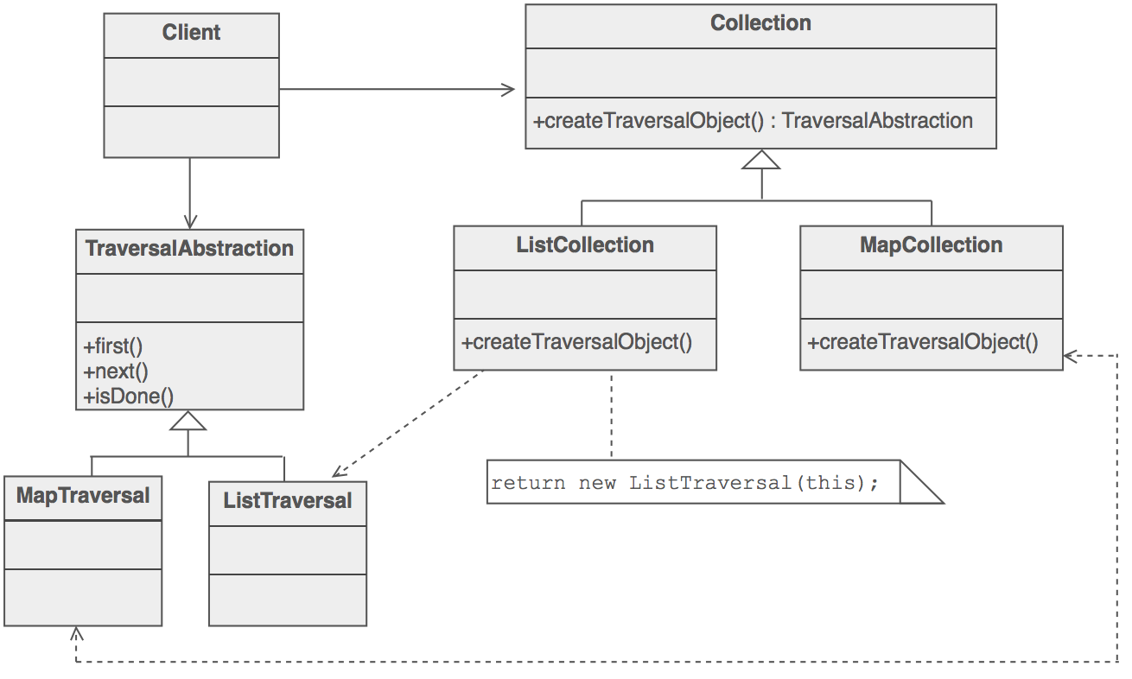
UML

Slide 31

Question & Answer
Any questions ?

Slide 32




Thank for your attention
www.sioux.asia
+84 (0) 5113888756
contact@sioux.asia

